Slide 1
CIS 4526 Foundations of Machine Learning
Chapter 10
Decision Trees

Slide 2
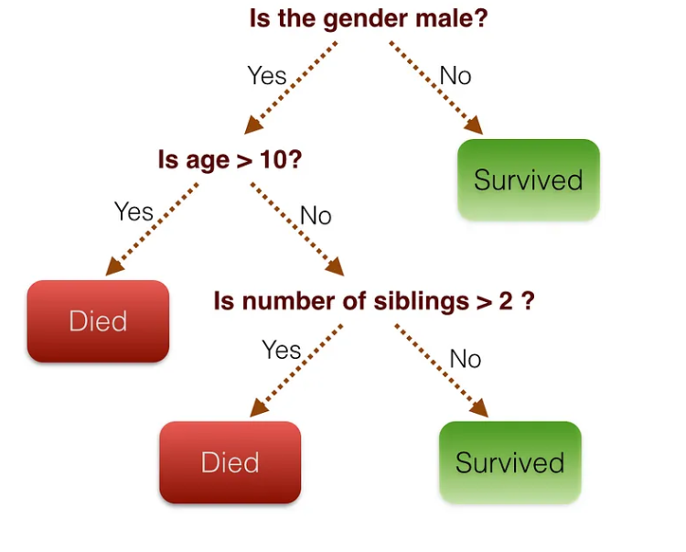
Decision Trees
Remember the Titanic dataset?
Follow if-then-else
logic to predict survival or not
Enchanted Random Forest. A quick guide to Decision Trees and…

Slide 3
Decision Trees
Decision trees are a simple hierarchically structured way to guide one’s path to a decision.
Decision tree learning is one of the most widely used techniques for classification.
Its classification accuracy is competitive with other methods, and
it is very efficient.
The classification model is a tree, called decision tree.
It can be used for Regression Analysis as well

Slide 4
Decision Trees Algorithm
Employs the divide and conquer method
Recursively divides a training set until each division consists of examples from one class
Create a root node and assign all of the training data to it
Select the best splitting attribute
Add a branch to the root node for each value of the split. Split the data into mutually exclusive subsets along the lines of the specific split
Repeat the steps 2 and 3 for each and every leaf node until the stopping criteria is reached

Slide 5
Decision Trees Algorithm
There are actually various variations in Decision Tree algorithms. They differ on
Splitting criteria
Which variable to split first? – Information Gain
What values to use to split?
How many splits to form for each node?
Stopping criteria
When to stop building the tree – Max tolerable error
Regularization methods
Pruning (generalization method)
Pre-pruning versus post-pruning

Slide 6
Example: Decision tree to decide whether to play golf
Outlook | Temp | Humidity | Windy | Play
Sunny | Hot | High | False | No
Sunny | Hot | High | True | No
Overcast | Hot | High | False | Yes
Rainy | Mild | High | False | Yes
Rainy | Cool | Normal | False | Yes
Rainy | Cool | Normal | True | No
Overcast | Cool | Normal | True | Yes
Sunny | Mild | High | False | No
Sunny | Cool | Normal | False | Yes
Rainy | Mild | Normal | False | Yes
Sunny | Mild | Normal | True | Yes
Overcast | Mild | High | True | Yes
Overcast | Hot | Normal | False | Yes
Rainy | Mild | High | True | No
Question: How to Select the best splitting attribute
Outlook | Temp | Humidity | Windy | Play
Sunny | Hot | Normal | True | ??

Slide 7
Evaluating the weather attributes
Outlook | Temp | Humidity | Windy | Play
Sunny | Hot | High | False | No
Sunny | Hot | High | True | No
Overcast | Hot | High | False | Yes
Rainy | Mild | High | False | Yes
Rainy | Cool | Normal | False | Yes
Rainy | Cool | Normal | True | No
Overcast | Cool | Normal | True | Yes
Sunny | Mild | High | False | No
Sunny | Cool | Normal | False | Yes
Rainy | Mild | Normal | False | Yes
Sunny | Mild | Normal | True | Yes
Overcast | Mild | High | True | Yes
Overcast | Hot | Normal | False | Yes
Rainy | Mild | High | True | No
Attribute | Rules | Error | Total Error
Outlook | Sunny→No | 2/5

Slide 8
Evaluating the weather attributes
Outlook | Temp | Humidity | Windy | Play
Sunny | Hot | High | False | No
Sunny | Hot | High | True | No
Overcast | Hot | High | False | Yes
Rainy | Mild | High | False | Yes
Rainy | Cool | Normal | False | Yes
Rainy | Cool | Normal | True | No
Overcast | Cool | Normal | True | Yes
Sunny | Mild | High | False | No
Sunny | Cool | Normal | False | Yes
Rainy | Mild | Normal | False | Yes
Sunny | Mild | Normal | True | Yes
Overcast | Mild | High | True | Yes
Overcast | Hot | Normal | False | Yes
Rainy | Mild | High | True | No
Attribute | Rules | Error | Total Error
Outlook | Sunny→No | 2/5
 | Overcast →yes | 0/4

Slide 9
Evaluating the weather attributes
Outlook | Temp | Humidity | Windy | Play
Sunny | Hot | High | False | No
Sunny | Hot | High | True | No
Overcast | Hot | High | False | Yes
Rainy | Mild | High | False | Yes
Rainy | Cool | Normal | False | Yes
Rainy | Cool | Normal | True | No
Overcast | Cool | Normal | True | Yes
Sunny | Mild | High | False | No
Sunny | Cool | Normal | False | Yes
Rainy | Mild | Normal | False | Yes
Sunny | Mild | Normal | True | Yes
Overcast | Mild | High | True | Yes
Overcast | Hot | Normal | False | Yes
Rainy | Mild | High | True | No
Attribute | Rules | Error | Total Error
Outlook | Sunny→No | 2/5 | 4/14
 | Overcast →yes | 0/4
 | Rainy →yes | 2/5

Slide 10
Evaluating the weather attributes
Outlook | Temp | Humidity | Windy | Play
Sunny | Hot | High | False | No
Sunny | Hot | High | True | No
Overcast | Hot | High | False | Yes
Rainy | Mild | High | False | Yes
Rainy | Cool | Normal | False | Yes
Rainy | Cool | Normal | True | No
Overcast | Cool | Normal | True | Yes
Sunny | Mild | High | False | No
Sunny | Cool | Normal | False | Yes
Rainy | Mild | Normal | False | Yes
Sunny | Mild | Normal | True | Yes
Overcast | Mild | High | True | Yes
Overcast | Hot | Normal | False | Yes
Rainy | Mild | High | True | No
Attribute | Rules | Error | Total Error
Outlook | Sunny→No | 2/5 | 4/14
 | Overcast →yes | 0/4
 | Rainy →yes | 2/5
Temp | Hot →No | 2/4 | 5/14
 | Mild →Yes | 2/6
 | Cool → Yes | 1/4
Humidity | High → No | 3/7 | 4/14
 | Normal →Yes | 1/7
Windy | False →Yes | 2/8 | 5/14
 | True →No | 3/6
Which attribute we should pick to spilt the dataset?
Lowest error: Outlook or Humidity

Slide 11
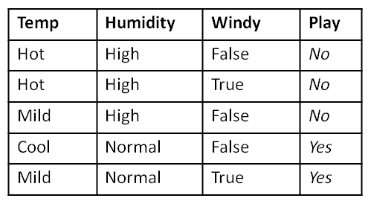
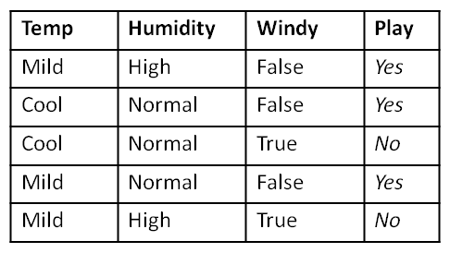
Decision tree after Iteration 1
Outlook
Sunny
Overcast
Rainy
YES

Slide 12
Decision tree after Iteration 1
Outlook
Sunny
Rainy
Overcast
YES
Attribute | Rules | Error | Total Error
Temp | Hot->No | 0/2 | 1/5
 | Mild ->No | 1/2
 | Cool -> yes | 0/1
Humidity | High->No | 0/3 | 0/5
 | Normal->Yes | 0/2
Windy | False->No | 1/3 | 2/5
 | True->Yes | 1/2
Attribute | Rules | Error | Total Error
Temp | Mild->Yes | 1/3 | 2/5
 | Cool->yes | 1/2
Humidity | High->No | 1/2 | 1/5
 | Normal->Yes | 1/3
Windy | False->Yes | 0/3 | 0/5
 | True-No | 0/2

Slide 13
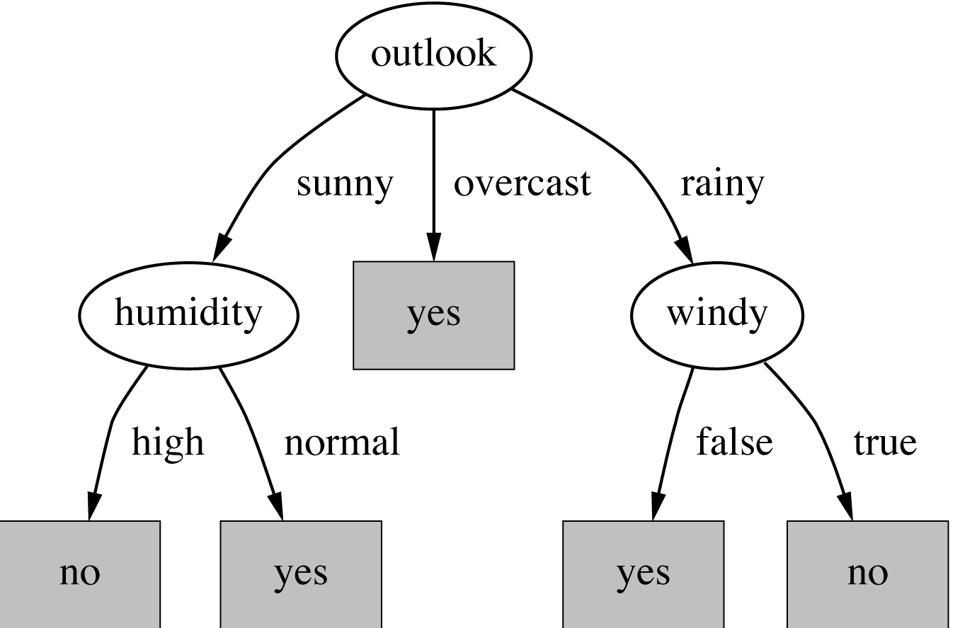
Decision tree
Outlook | Temp | Humidity | Windy | Play
Sunny | Hot | Normal | True | YES
Predict using the model

Slide 14
Decision tree (for weather/play problem)
Not all leaves need to be pure; sometimes identical instances have different class.
Splitting stops when data can’t be split any further
Lowest error in each iteration means the “subset” is becoming more homogenous

Slide 15
Decision Trees
Now that we have an intuitive ideas how a decision tree is constructed. Let’s focus on more precisely how to create a tree.
Remember the important question in tree construction is how to pick which attributes to split the tree on. This brings up the concept of information gain and entropy
https://towardsdatascience.com/decision-tree-in-python-b433ae57fb93
https://www.analyticsvidhya.com/blog/2021/03/how-to-select-best-split-in-decision-trees-using-information-gain/
https://towardsdatascience.com/enchanted-random-forest-b08d418cb411#.hh7n1co54

Slide 16
Decision Trees (code)
Model Parameters:
Max_depth : maximum depth of the trees
Criterion: default is “gini”, other choice is “entropy”
model = DecisionTreeClassifier(max_depth=3, criterion='entropy’)
model = DecisionTreeClassifier(max_depth=3, criterion=‘gini')

Slide 17
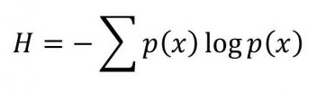
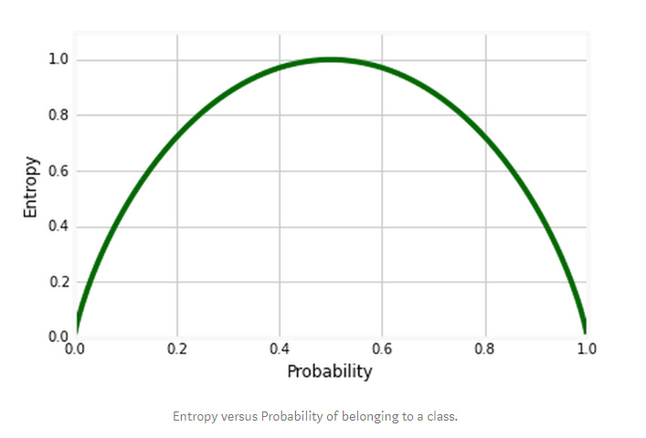
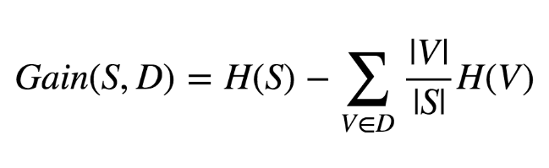
Entropy and Information Gain
High Entropy
Mixed cases = Heterogenous
Example: 50% boy + 50% girls
Low Entropy
Pure cases, homogenous
Example: 90% boy + 10% girls
or 10% boy + 90% girls
Entropy formula:
Information Gain from splitting a dataset S into different partition V

Slide 18
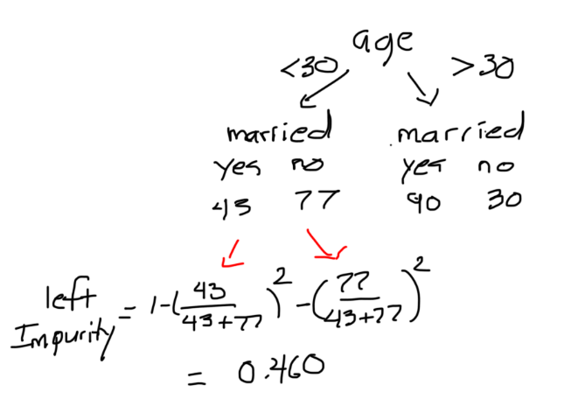
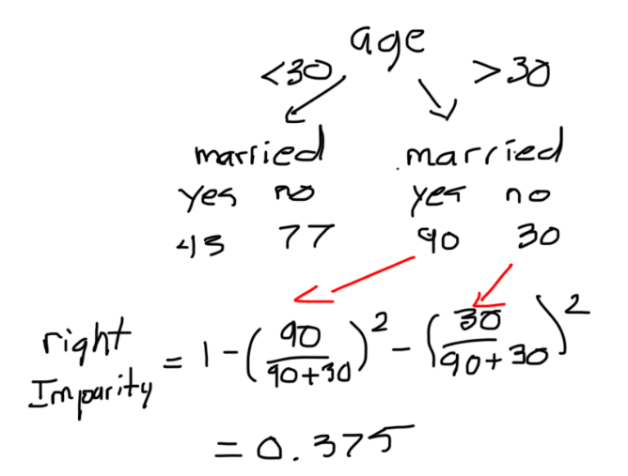
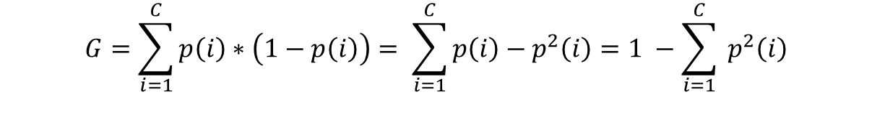
Gini Index: G = $\sum_{i=1}^{C}{p\left(i\right)∗\left( 1 −p\left(i\right)\right) }$
$$G=\sum_{i=1}^{C}{p\left(i\right)∗\left(1−p\left(i\right)\right)= \sum_{i=1}^{C}{p\left(i\right)−p^{2}\left(i\right)=1 −\sum_{i=1}^{C}{ p^{2}\left(i\right)}}}$$
For pure class: When P(i) is 1 or 0, G = 0
For mix class: When P(i) = 0.5, G = 0.5

Slide 19
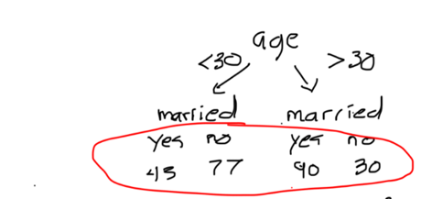
Gini Index
Information gain is the difference in impurity before and after the split
Information gain = 0.494 – (120/240)(0.375)
-- (120/240) (0.460)
Impurity before the split =
1 – (133/240)^2 – (107/240)^2 = 0.494
Note that: in the original blog, the author use the impurity based on age to calculate the impurity before the split. But it should be based on the proportion on married=Yes and No instead

Slide 20
Decision Tree Algorithms Family
Decision-Tree | C4.5 | CART | CHAID
Full Name | Iterative Dichotomiser (ID3) | Classification and Regression Trees | Chi-square Automatic Interaction Detector
Basic algorithm | Hunt’s algorithm | Hunt’s algorithm | adjusted significance testing
Developer | Ross Quinlan | Bremman | Gordon Kass
When developed | 1986 | 1984 | 1980
Types of trees | Classification | Classification & Regression trees | Classification & regression
Serial implementation | Tree-growth & Tree-pruning | Tree-growth & Tree-pruning | Tree-growth & Tree-pruning
Type of data | Discrete & Continuous; Incomplete data | Discrete and Continuous | Non-normal data also accepted
Types of splits | Multi-way splits | Binary splits only; Clever surrogate splits to reduce tree depth | Multi-way splits as default
Splitting criteria | Information gain | Gini’s coefficient, and others | Chi-square test
Pruning Criteria | Clever bottom-up technique avoids overfitting |  | Trees can become very large
Implementation | Publicly available | Publicly available in most packages | Popular in market research, for segmentation

Slide 21
Random Forests
Repeatedly select data from the data set with replacement and build a separate tree with each new training set. Each of these trees built will be used to make new forecast. The class label that receive the most votes becomes the predicted class for that data point
Each tree may be a “weak” classifier and is subject to overfitting from the specific training sample dataset. However, by building not just one tree, but multiple trees for different training samples, the hope is that the combined forecast from individual “weak” classifiers may become a “strong” classifier
This is the basic idea behind the “Ensemble methods”, in which we combine multiple machine learning algorithms to obtain better predictive performance. We’ll run multiple models on the data and use the aggregate predictions, which will be better than a single model alone.

Slide 22
Decision Trees
Learning by doing

